Slide 1
INDOOR POSITIONING WITH BLE BEACONS
This controller is based on BLE beacons and Trilateration.
The system will automatically turn a permanent Light ON/OFF whenever someone enters/leaves the room.
A specific position Light (E.g. Table Lamp) will be turned ON/OFF automatically when someone reaches/leaves the specific Area (Around the table).
The user can monitor the system operation using the user friendly Node Red dashboard on their smartphone.
EN2560
GROUP 06

Slide 2
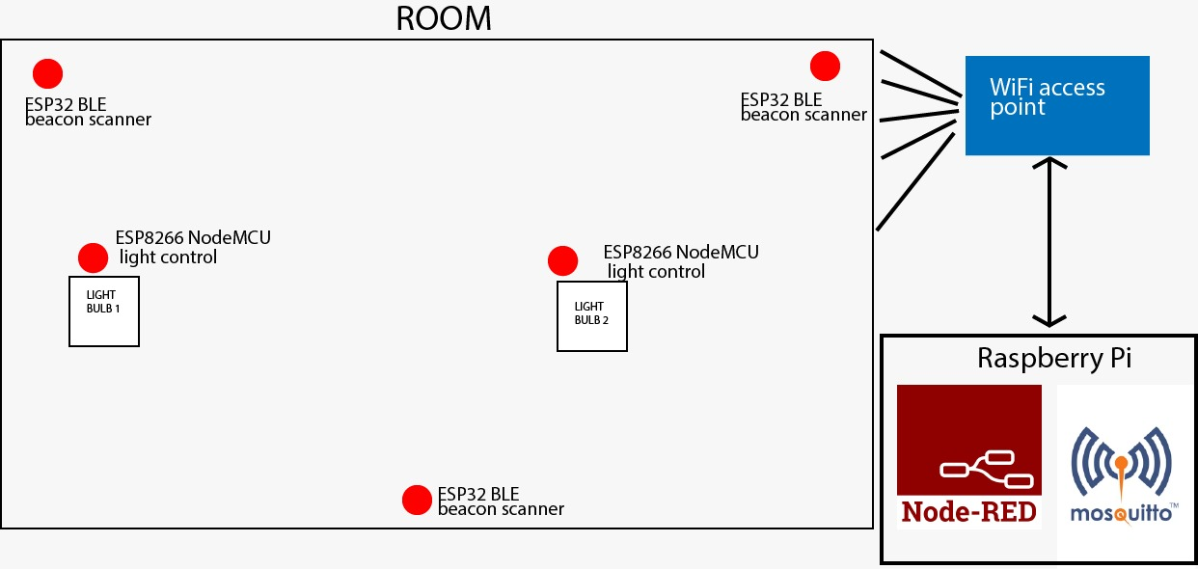
System Implementation
The system consists of
Three ESP32 BLE Beacon scanners
ESP8266 NodeMCUs to control Lights.
A WIFI access point
Raspberry Pi model 3B+ to host Node Red & MQTT Broker
BLE Beacons (Smart phone connected with Beacon Simulator application)

Slide 3
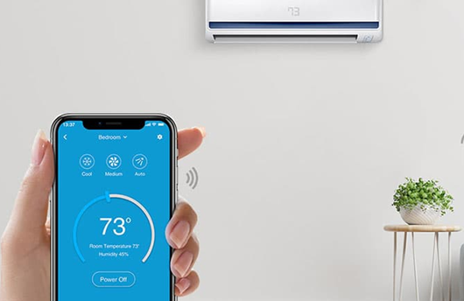
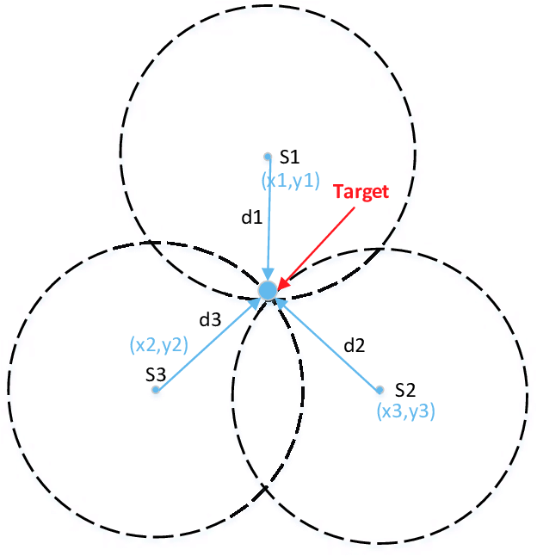
Problems faced
Sometimes RSSI readings of three scanners at a position changes rapidly due to noise and interference.
(Solved by using Median Filtering.)
Channel contention due to too many devices accessing the same physical layer.
Improvements
Location tracking
Location-Based Notifications
Role-based Indoor Navigation Guide
Differential Temperature Control

Slide 4
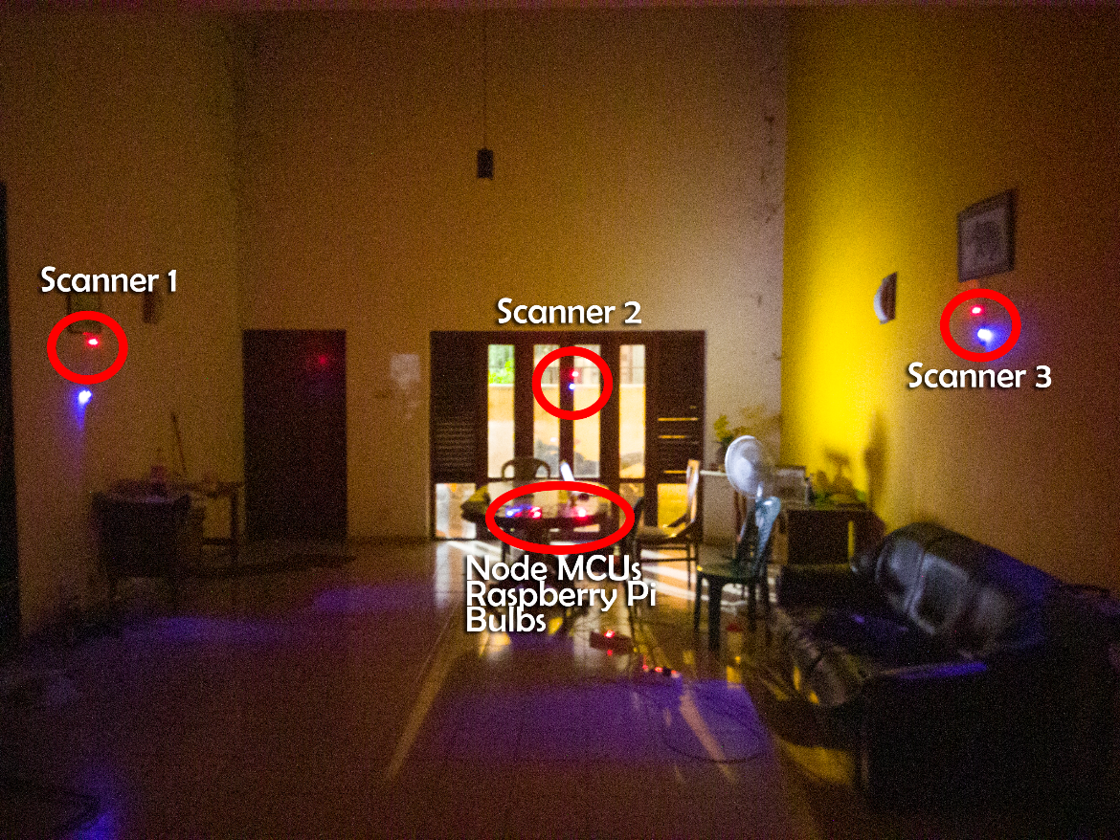
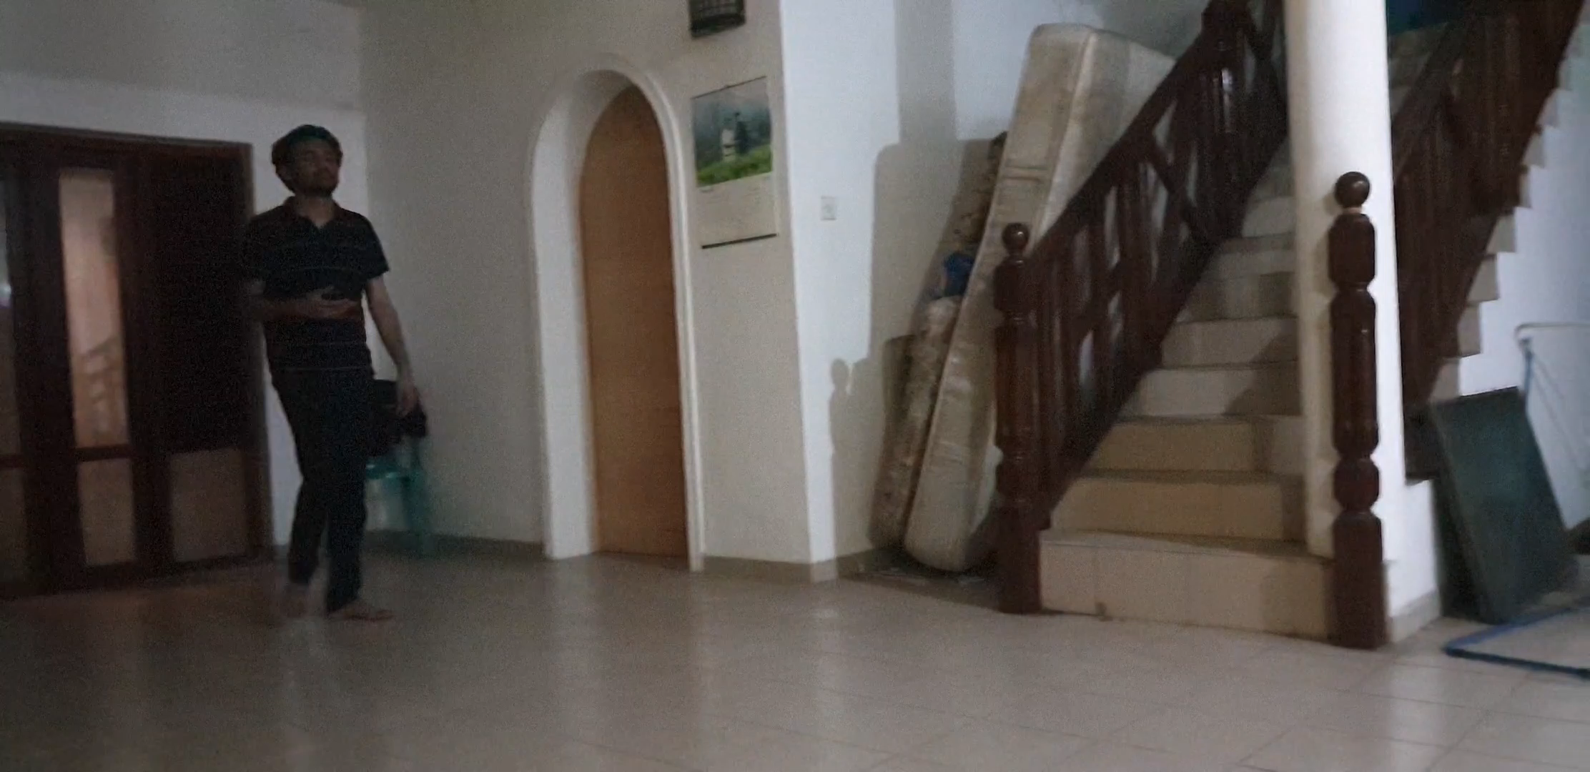
System functionality achieved

